Slide 1

Transfusion
Training Guide

Slide 2
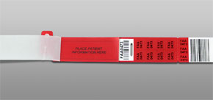


Sample Collection Overview
It is the responsibility of the transfusing facility to collect and properly label blood samples for testing
Samples should only be collected by individuals who have completed this and any other training required by your facility
Packets are provided to your facility for sample collection that include sample tubes, a blood bank wristband and a request form

Slide 3
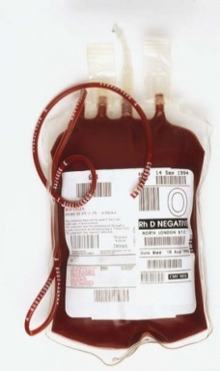
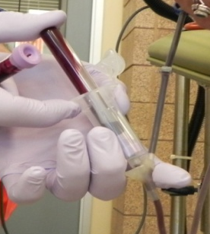
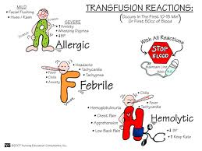

Sample Collection Materials
Information Sheet for Transfusion Facilities (J.057)- provided to your facility in each collection packet or in the blood center information binder. It contains helpful information about:
  sample collection
  product issue
  transfusion requirements
  identifying and managing suspected transfusion reactions
  emergency release of blood products

Slide 4
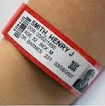
Patient Identification
The most important step in collecting a sample for a type and screen or a type and crossmatch is proper patient identification!
Verify the patient’s identity by asking the patient to state:
  First and last name
  Date of birth
  Social security number (as permitted per your facility’s protocol)

Slide 5
Preparing the Wristband
Label the blood bank wristband by either handwriting the information onto the wristband or using pre-printed patient labels as required by the Directions For Use for the wristband being used. Required information:
  Full Name
  ID Number (SS#, medical record number or date of birth may be used)
  Date of collection
  Time of collection
  Initials of the person collecting the specimens
The Directions For Use for the wristbands are located in the blood center information binder.

Slide 6
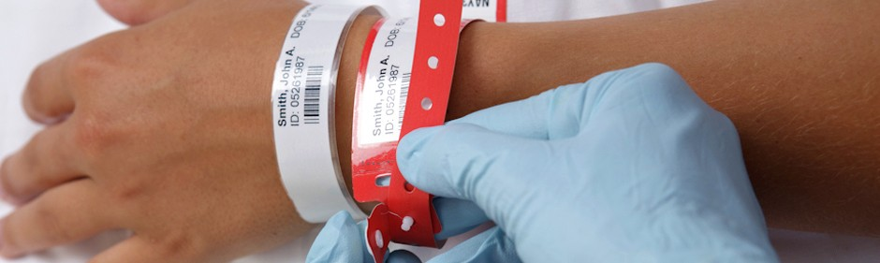
Apply the Wristband
Place the wristband on the patient according to the Directions For Use.
Tear off the extra ‘tail’ of labels. These can be used at your facility or sent with the samples to the blood center.

Slide 7
Collect Primary Samples
Collect 2 blood samples in the EDTA sample tubes provided.
Label each tube with the following information (pre-printed patient labels may be used):
  Full Name
  ID Number (SS#, medical record number or date of birth may be used)
  Blood Bank ID# (use a barcoded sticker from the tail of the band)
  Date and Time of collection
  Initials of the person collecting the specimens
Be sure to write the date and time of collection and initial each sample! Failure to do so will result in recollecting the samples and delay in testing and receiving products.

Slide 8
Collect a Secondary Sample
Collect 1 additional EDTA sample tube. This second sample must be collected on all patients at a different time than the original samples. This sample will be used to perform a second blood type verification to ensure patient transfusion safety.
Label this tube with the same information as the primary samples (pre-printed patient labels may be used):
  Full Name
  ID Number (SS#, medical record number or date of birth may be used)
  Blood Bank ID# (use a barcoded sticker from the tail of the band)
  Date and Time of collection
  Initials of the person collecting the specimens
Be sure to write the date and time of collection and initial each sample! Failure to do so will result in recollecting the samples and delay in testing and receiving products.

Slide 9
Complete Request Form
Complete the Transfusion Medicine Request Form with:
All prompted patient identification information
Testing required
The type and amount of blood products needed
Any special transfusion needs of the patient such as CMV- , irradiated or washed RBCs
The patient’s blood transfusion and pregnancy history, as well as any known information about antibodies
  If this information is not readily available to you, please ask the patient or a relative of the patient. It is important to the safety of the transfusion that this information is obtained!

Slide 10
Platelet Orders
Minimum testing required: ABO/Rh Blood Type
If a patient has already had a type and screen performed and is still wearing the blood bank wristband, no additional testing is required

Slide 11
Verify Accuracy
Ensure all information on the samples, wristband and request form are identical.
It is advisable to have a second check by another individual to ensure specimen labeling requirements have been met before sending the sample to the blood center.
Check!
Check!
Check!

Slide 12
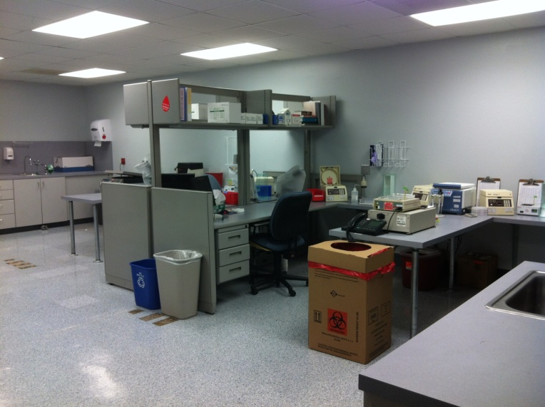

Send Samples to the Blood Center
Sample delivery options:
  We Are Blood can pick them up
  You can use your courier
  You can send them via cab
When the samples arrive at our facility, we will verify the sample labeling matches the request. If an error is identified in the request form, we can fax it to you for correction. If an error is identified in the sample labeling, it may require a sample recollect.
This is our lab where we test your samples.

Slide 13
Product Issue
Products can be picked up from We Are Blood by your facility’s courier or delivered by We Are Blood
Once products are released to your facility, they cannot be returned (unless stored in a validated refrigerator approved for use by We Are Blood)
Patient information needed from your facility prior to release of products:
  Patient name, Medical Record Number or Social security number, and Typenex (blood bank wristband) number
  Note: This information should be obtained from the patient’s armband attached to the patient - NOT the patient’s chart. If you discover that the patient is NOT wearing the armband at the time of the anticipated transfusion, call We Are Blood laboratory immediately.

Slide 14
Product Issue
The lab technologist will verify the information provided prior to release of products
  Discrepancy? recollect patient/repeat testing
Ready to transfuse?
  If product(s) are delivered by We Are Blood, they will be left without a cooler.
  You will have 4 hours to complete transfusion from time of delivery.
Not quite ready to transfuse?
  Product(s) will be left in a cooler. They can remain in the cooler for up to 6 hours. A note on the cooler will let you know how long the products can remain in the cooler.
  You will have 4 hours to complete transfusion from the time products were removed from the cooler.

Slide 15
Transfusion
Patient Consent
  Required prior to transfusion, consent shall include:
    A description of the risks, benefits and treatment alternatives (including nontreatment)
    The opportunity to ask questions
    The right to accept or refuse transfusion

Slide 16
Transfusion
Immediately before transfusion, the transfusionist and one other individual shall, in the presence of the recipient, verify the following information matching the blood or blood component with the intended recipient:
  The intended recipient’s identification (Name, Medical Record Number or Social security number, and Typenex (blood bank wristband) number
  The intended recipient’s ABO group and Rh type.
  The donation (product) identification number
  The donor ABO group and Rh type
  The interpretation of crossmatch test
  Special transfusion requirements
  The expiration date of the product (product is not expired)
Note: This information must be verified with the patient’s armband on the patient-NOT from the patient’s chart. If you discover that the patient is NOT wearing the armband at the time of the anticipated transfusion, call We Are Blood laboratory immediately.

Slide 17
Transfusion
Monitor transfusion per your facility’s policy
AABB Standards state:
All identification attached to the container shall remain attached until the transfusion has been terminated.
The patient shall be monitored for potential adverse events during the transfusion and for an appropriate time after transfusion.
Specific written instructions concerning possible adverse events, including emergency medical care contacts, shall be provided to the patient or a responsible caregiver when direct medical observation or monitoring of the patient will not be available after transfusion.
Blood and blood components shall be transfused through a sterile, pyrogen-free transfusion set that has a filter designed to retain particles potentially harmful to the recipient.
With the exception of 0.9% sodium chloride (USP), drugs or medications shall not be added to blood or blood components unless:
  approved for this use by the FDA, or
  There is documentation available to show that the addition is safe and does not adversely affect the blood or blood component

Slide 18
Transfusion Documentation
Include in the patient’s medical record:
  The transfusion order
  Patient consent
  The name of the component
  The donation ID #
  Date and time of transfusion
  Pre- and post-transfusion vital signs
  Amount transfused
  Transfusionist ID
  Any transfusion-related adverse events

Slide 19
Transfusion Reactions
Signs and symptoms of a transfusion reaction:
  Febrile- fever and/or chills
  Allergic- Mild urticaria, itching, flushing
  Severe allergic- Blood pressure changes, asthma, edema, nausea/vomiting, diarrhea
  Hemolytic- fever, chills, chest/flank pain, hypotension, nausea/vomiting, flushing, dyspnea, hemoglobinuria, DIC, oliguria, pain at needle site, shock, generalized bleeding

Slide 20
Transfusion Reactions
If you suspect a transfusion reaction:
  Stop the transfusion immediately, but keep the IV open
  Recheck the patient identification and product information
  Notify the ordering physician STAT
  Notify We Are Blood laboratory

Slide 21
Transfusion Reactions
If the physician requests a transfusion reaction investigation:
  Notify We Are Blood lab. They will fax an investigation form to you, and guide you through the investigation process.
  Complete and return the investigation form as soon as possible along with:
    Product bag and all attached solutions in a biohazard bag. Remove all needles!
    A plain red top tube (no serum separator) and an EDTA tube properly labeled according to the Sample Collection protocol. Label tubes “post-reaction”.
  We Are Blood laboratory will perform a STAT investigation and notify your facility of testing results.
DO NOT transfuse additional blood products without instruction from We Are Blood laboratory. Medical Director review and approval is required prior to transfusions subsequent to a transfusion reaction.

Slide 22
Emergency Release of Blood Products
Steps to take if blood is needed emergently:
Call We Are Blood laboratory. Be prepared with the following information:
  Patient’s name
  Requesting Physician (the physician will be required to sign for responsibility to transfuse uncrossmatched units).
Collect samples according to the Sample Collection protocol. Samples will be picked up at the time the uncrossmatched products are delivered.
Each uncrossmatched unit will have an Emergency Release form with it.

Slide 23
Emergency Release of Blood Products
The employee receiving the uncrossmatched products must sign the Emergency Release form acknowledging receipt of the products.
The physician, transfusionist, and one other individual must then sign the Emergency Release form acknowledging responsibility for the transfusion.
Fax the completed form to We Are Blood as soon as possible after completion.
Crossmatch testing will be performed STAT and results will be called to your facility.
If the emergent situation continues, it is recommended to transport the patient to the nearest hospital, as We Are Blood cannot support transfusion requirements of an ongoing nature.

Slide 24
Emergency Release of Blood Products
Emergency Preparedness is Important!
Emergency release drills can be coordinated with We Are Blood.

Slide 25
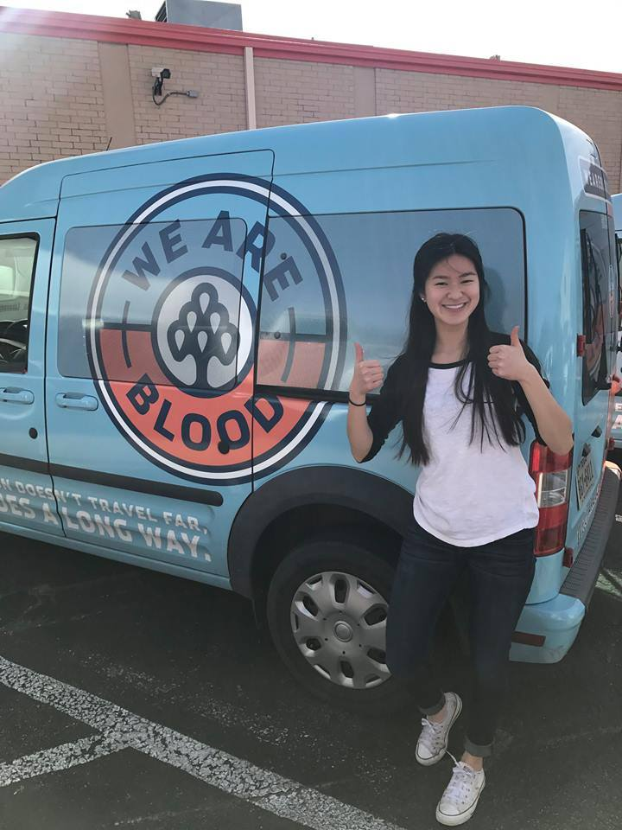
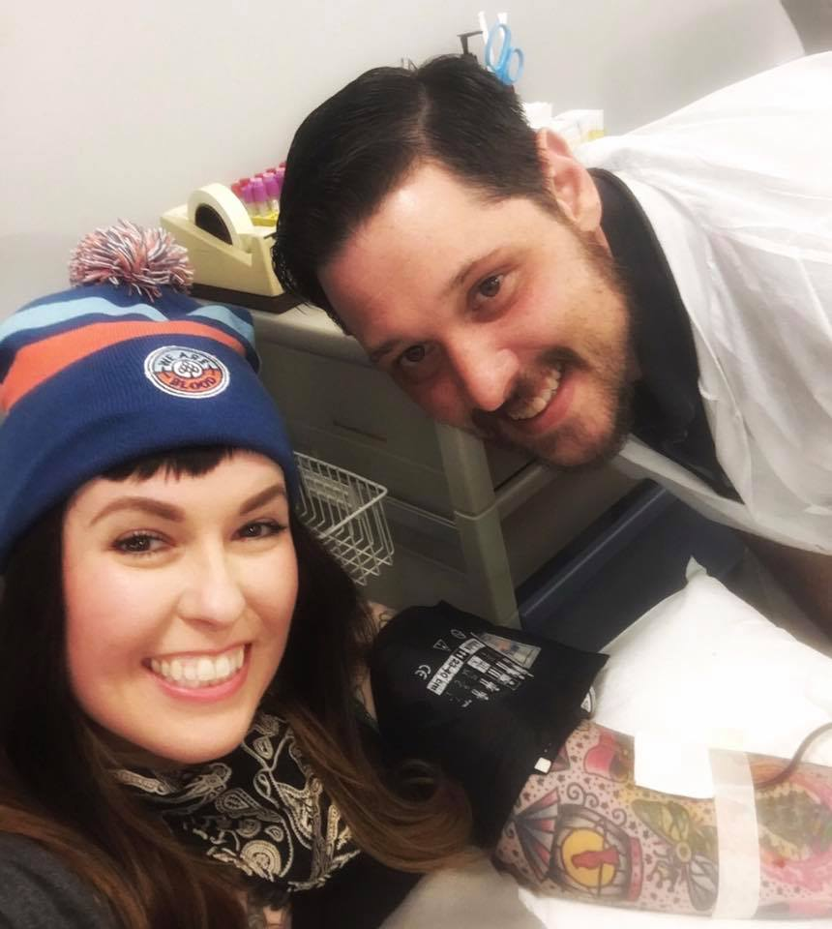


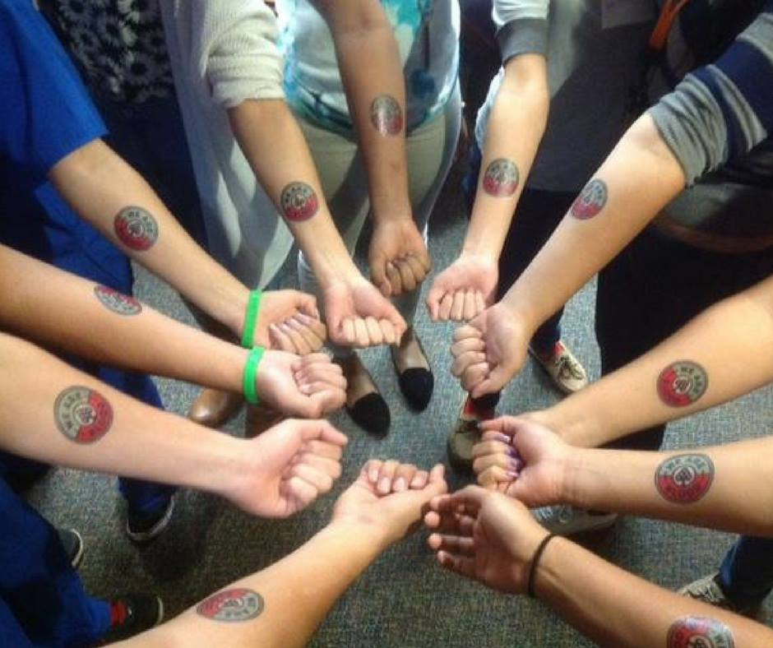

The End

